Slide 1
Solidity development
Blockchain fundamental
Chrisando Ryan Pardomuan

Slide 2
Materials in this presentation will be delivered in two separate sessions (S05 and s07). Lecturer should manage the proportion accordingly.

Slide 4
Life cycle of a smart contract
The compilation
Smart contracts are written in high-level languages like Solidity.
They must be compiled into low-level bytecode to run on the Ethereum Virtual Machine (EVM).
Once compiled, they are deployed on the Ethereum platform using a special contract creation transaction, which is done by sending the contract to the special contract creation address, namely 0x0.
Each contract gets an Ethereum address derived from the creation transaction, originating account, and nonce.
The Ethereum address can be used to send funds to the contract or call its functions.

Slide 5
Life cycle of a smart contract
The execution
Contracts only run when called by a transaction from an Externally Owned Account (EOA).
A contract can call other contracts, but the initial trigger must come from an EOA transaction.
Contracts remain dormant until activated by a transaction, either directly or through a chain of calls.
Smart contracts are executed sequentially, not in parallel, like a single-threaded machine.

Slide 6
Life cycle of a smart contract
The termination
A contract's code cannot be changed, but it can be deleted using the SELFDESTRUCT opcode.
Deleting a contract removes its code and internal state, leaving a blank account.
Transactions sent to a deleted contract address do not result in code execution.
SELFDESTRUCT provides a gas refund, incentivizing the release of network resources.
Deleting a contract does not remove its transaction history, as the blockchain is immutable.
The SELFDESTRUCT capability must be programmed into the smart contract by the author.
If the contract lacks a SELFDESTRUCT opcode or it is inaccessible, the contract cannot be deleted.

Slide 7
Programming with solidity
Data types
Boolean (bool)
Boolean value, true or false, with logical operators.
Integer (int, uint)
Signed (int) and unsigned (uint) integers, declared in increments of 8 bits from int8 to uint256.
Fixed point (fixed, ufixed)
Fixed-point numbers
Address
A 20-byte Ethereum address. The address object has many helpful member functions, the main ones being balance (returns the account balance) and transfer (transfers ether to the account).

Slide 8
Programming with solidity
Data types
Byte array (fixed)
Fixed-size arrays of bytes.
Byte array (dynamic)
Variable-sized arrays of bytes, declared with bytes or string.
Enum
User-defined type for enumerating discrete values: enum NAME {LABEL1, LABEL 2, ...}.
Arrays
An array of any type, either fixed or dynamic.

Slide 9
Programming with solidity
Predefined global variables
Variable | Type | Description
msg.sender | address | The address of the account that sent the current transaction.
msg.value | uint | The amount of Ether sent with the current transaction.
block.coinbase | address | The address of the miner who mined the current block.
block.difficulty | uint | The difficulty of the current block.
block.gaslimit | uint | The maximum amount of gas that can be used in the current block.

Slide 10
Programming with solidity
Predefined global variables
Variable | Type | Description
block.number | uint | The number of the current block.
block.timestamp | uint | The timestamp of the current block.
now | uint | An alias for block.timestamp.
tx.origin | address | The address of the account that originally created the transaction (i.e., the sender of the first transaction in the call chain).
tx.gasprice | uint | The gas price (in Wei) of the current transaction.

Slide 11
Programming with solidity
Contract definition
Solidity’s principal data type is contract.
Similar to any object in an object-oriented language, the contract is a container that includes data and methods.
Besides contract, Solidity offers two other object types:
Interface
An interface definition is structured exactly like a contract, except none of the functions are defined, they are only declared.
When inherited, each of the functions declared by the interface must be defined by the child.
Library
A library contract is one that is meant to be deployed only once and used by other contracts, using the delegatecall method.

Slide 12
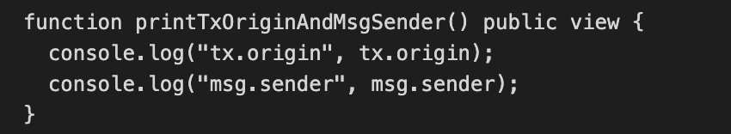
Programming with solidity
Function definition
Within a contract, we define functions that can be called by an EOA transaction or another contract.
The syntax we use to declare a function in Solidity is as follows:
function FunctionName([parameters]) {public|private|internal|external} [pure|view|payable] [modifiers] [returns (return types)]
For example:

Slide 13
Programming with solidity
Function visibility
function FunctionName([parameters]) {public|private|internal|external} [pure|view|payable] [modifiers] [returns (return types)]
FunctionName
The name of the function, which is used to call the function in a transaction (from an EOA), from another contract, or even from within the same contract.
One function in each contract may be defined as a fallback function using the "fallback" keyword or a receive ether function defined using the "receive" keyword (see previous session).
Parameters
Following the name, we specify the arguments that must be passed to the function, with their names and types.

Slide 14
Programming with solidity
Function components
function FunctionName([parameters]) {public|private|internal|external} [pure|view|payable] [modifiers] [returns (return types)]
Public
Public is the default; it can be called by other contracts or EOA transactions, or from within the contract.
External
External functions are like public functions, it can’t be called from within the contract unless explicitly prefixed with ‘this’.
Internal
Internal functions are only accessible from within the contract. They can be called by derived contracts (those that inherit this one).
Private
Private functions are like internal functions but cannot be called by derived contracts.

Slide 15
Programming with solidity
Function Behaviour
function FunctionName([parameters]) {public|private|internal|external} [pure|view|payable] [modifiers] [returns (return types)]
constant or view
A function marked as a view promises not to modify any state.
pure
A pure function is one that neither reads nor writes any variables in storage.
It can only operate on arguments and return data, without reference to any stored data.
Payable
A payable function is one that can accept incoming payments.

Slide 16
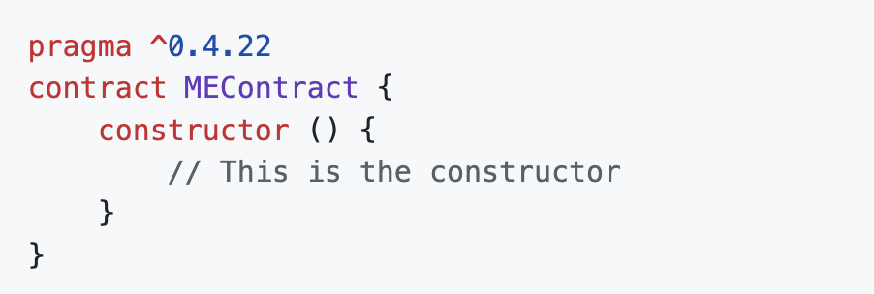
Programming with solidity
Constructor
When a contract is created, it also runs the constructor function if one exists, to initialize the state of the contract.
The constructor is run in the same transaction as the contract creation, but will only be used once.
The constructor function is optional, not every contract should have a constructor.

Slide 17
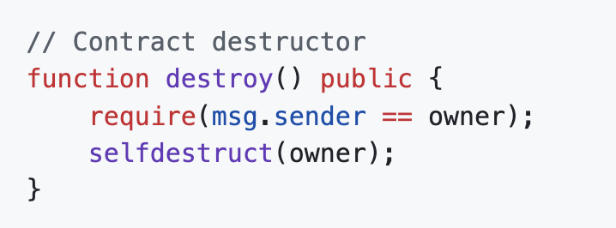
Programming with solidity
selfdestruct
Contracts are destroyed by a special EVM opcode called SELFDESTRUCT.
It used to be called SUICIDE, but that name was deprecated due to the negative associations of the word.
In Solidity, this opcode is exposed as a high-level built-in function called selfdestruct, which takes one argument: the address to receive any ether balance remaining in the contract account.

Slide 18
Programming with solidity
selfdestruct
From the previous code, if anyone calls this destroy function from an address other than owner, it will fail.
But if the same address stored in owner by the constructor calls it, the contract will self-destruct and send any remaining balance to the owner address.
Note that, as of Solidity 0.8.18, SELFDESTRUCT is deprecated.

Slide 19
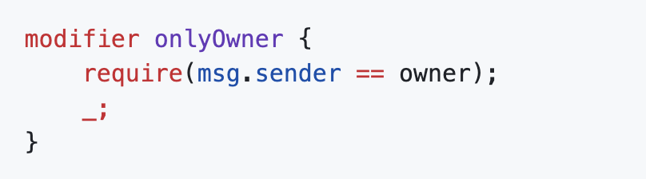
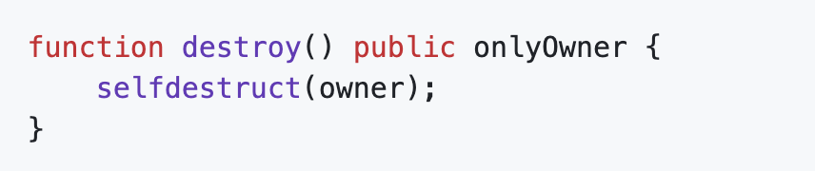
Programming with solidity
Function modifiers
Solidity offers a special type of function called a function modifier.
Modifiers are most often used to create conditions that apply to many functions within a contract.
The function modifier below, named onlyOwner, sets a condition on any function that it modifies, requiring that the address stored as the owner of the contract is the same as the address of the transaction’s msg.sender.
This is the basic design pattern for access control, allowing only the owner of a contract to execute any function that has the onlyOwner modifier.
Read this as: ONLY OWNER CAN DESTROY THIS CONTRACT.

Slide 20
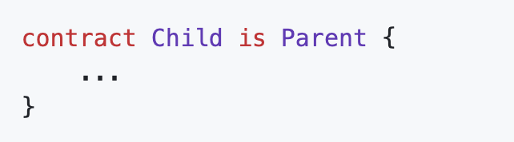
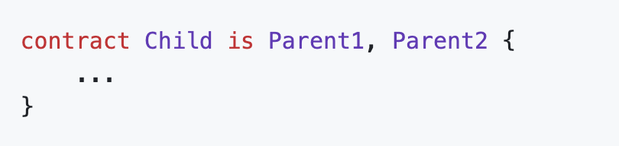
Programming with solidity
CONTRACT INHERITANCE
Solidity’s contract object supports inheritance, which is a mechanism for extending a base contract with additional functionality.
Solidity also supports multiple inheritance, which can be specified by comma-separated contract names.
With this construct, the Child contract inherits all the methods, functionality, and variables of Parent.
With this construct, the Child contract inherits all the methods, functionality, and variables of Parent1 and Parent2.

Slide 21
Programming with solidity
Error handling (asset, require)
A contract call can terminate and return an error.
Error handling in Solidity is handled by four functions: assert, require, revert, and throw (now deprecated).
When a contract terminates with an error:
All state changes (changes to variables, balances, etc.) are reverted.
This reversion occurs up the chain of contract calls if multiple contracts were called.
Ensures transactions are atomic, meaning they either complete successfully or are entirely reverted.

Slide 22
Programming with solidity
Error handling: asset and require
The assert and require functions operate in the same way, evaluating a condition and stopping execution with an error if the condition is false.
By convention, assert is used when the outcome is expected to be true, meaning that we use assert to test internal conditions.
By comparison, require is used when testing inputs (such as function arguments or transaction fields), setting our expectations for those conditions.
require(msg.sender == owner, "Only the contract owner can call this function");
assert(totalSupply == balances_from + balances_to);

Slide 23
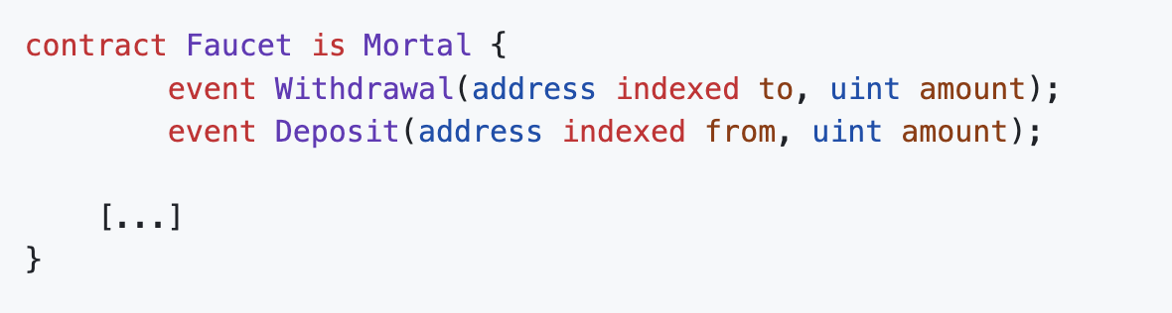
Programming with solidity
events
When a transaction completes (successfully or not), it produces a transaction receipt.
The transaction receipt contains log entries that provide information about the actions that occurred during the execution of the transaction.
Light clients and DApp services can "watch" for specific events to:
Report them to the user interface
Make a change in the state of the application to reflect an event in an underlying contract.
The keyword indexed make the value part of an indexed table (hash table) that can be searched or filtered by an application.

Slide 24
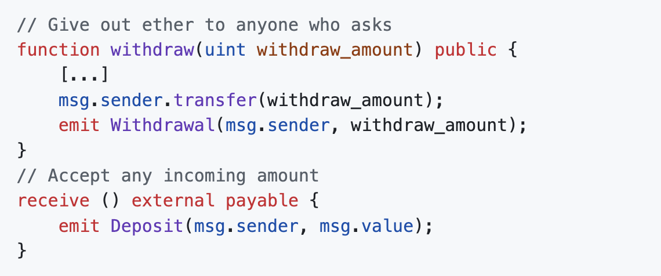
Programming with solidity
events
To trigger the event data into the transaction logs, we use the emit keyword.

Slide 25
Programming with solidity
Calling other contracts
Calling other contracts from within your contract is very useful but potentially dangerous.
Risks could arise from:
Uncertainty about the contract you are calling into.
Uncertainty about the contract that is calling into your contract.
You may mostly expect to deal with Externally Owned Accounts (EOAs).
There is nothing to stop arbitrarily complex and possibly malicious contracts from calling into your code.
Similarly, your contract might call into other unknown and potentially dangerous contracts.

Slide 26
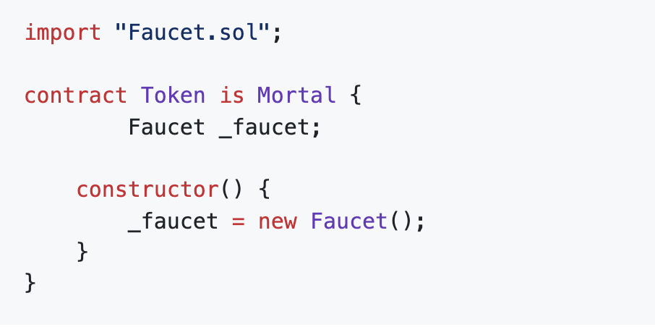
Programming with solidity
Creating a new contract instance
The safest way to call another contract is if you create that other contract yourself.
That way, you are certain of its interfaces and behavior.

Slide 27
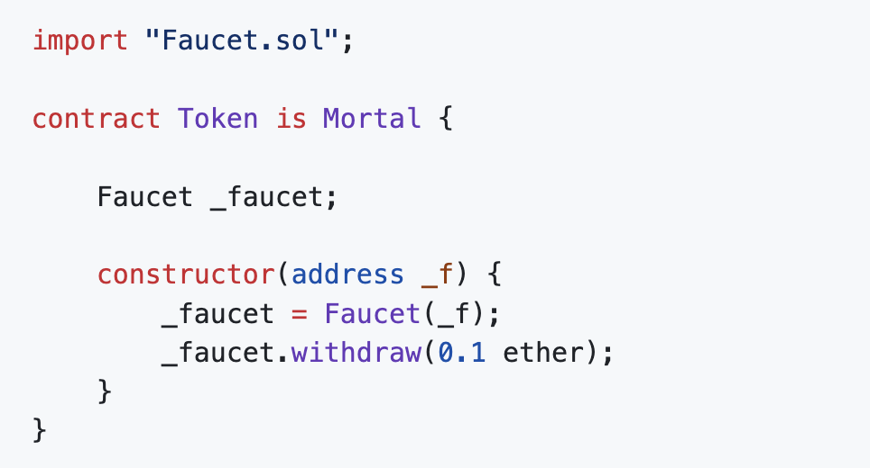
Programming with solidity
Addresing an existing instance
Another way you can call a contract is by casting the address of an existing instance of the contract.
With this method, you apply a known interface to an existing instance.
It is therefore critically important that you know, for sure, that the instance you are addressing is in fact of the type you assume.

Slide 28
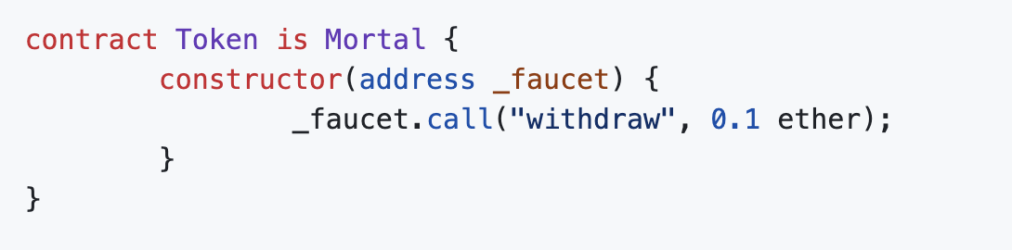
Programming with solidity
RAW CALL
Solidity offers some even more "low-level" functions for calling other contracts.
These correspond directly to EVM opcodes of the same name and allow us to construct a contract-to-contract call manually.
This is the most flexible and the most dangerous mechanism for calling other contracts.

Slide 29
references
https://github.com/ethereumbook/ethereumbook/blob/develop/07smart-contracts-solidity.asciidoc

